Slide 1
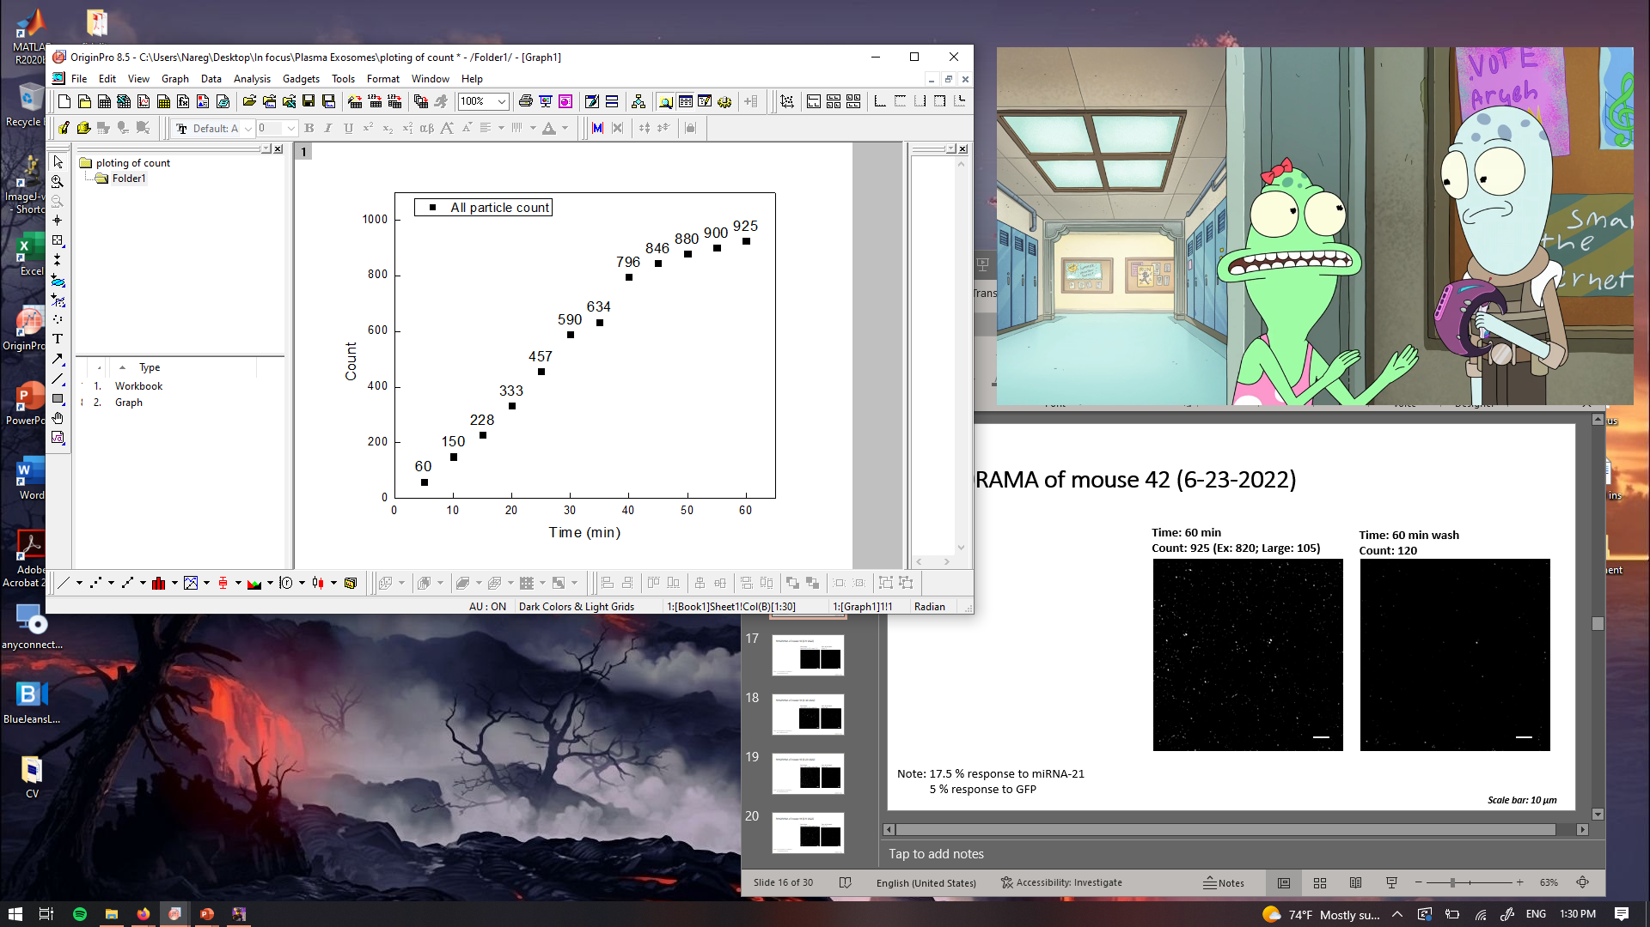
PANORAMA of mouse 42 (6-23-2022)
Time: 60 min
Count: 925 (Ex: 820; Large: 105)
Time: 60 min wash
Count: 120
Note: 17.5 % response to miRNA-21
5 % response to GFP
Scale bar: 10 µm

Slide 2
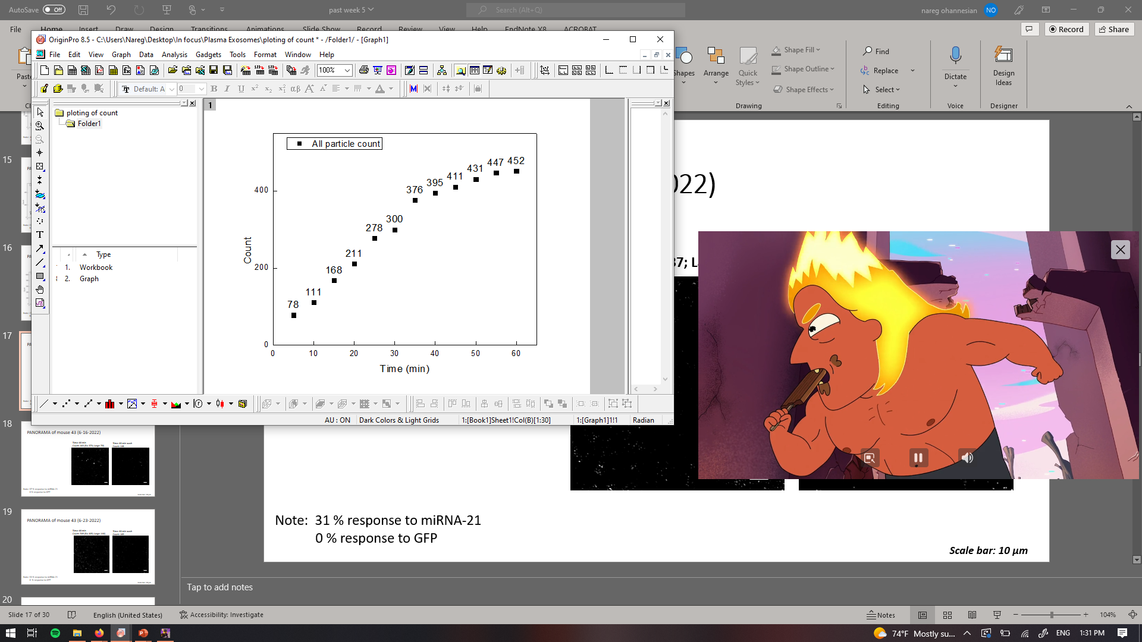

PANORAMA of mouse 43 (6-9-2022)
Time: 60 min
Count: 452 (Ex: 337; Large: 115)
Time: 60 min wash
Count: 77
Note: 31 % response to miRNA-21
0 % response to GFP
Scale bar: 10 µm

Slide 3
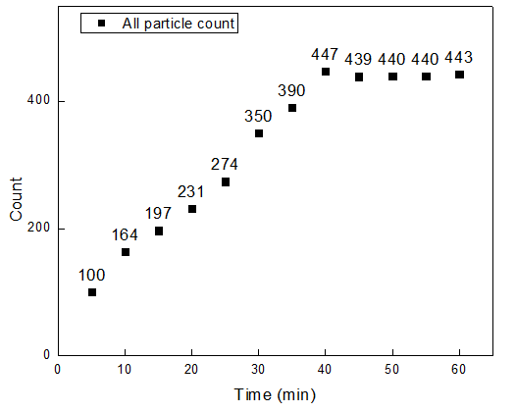
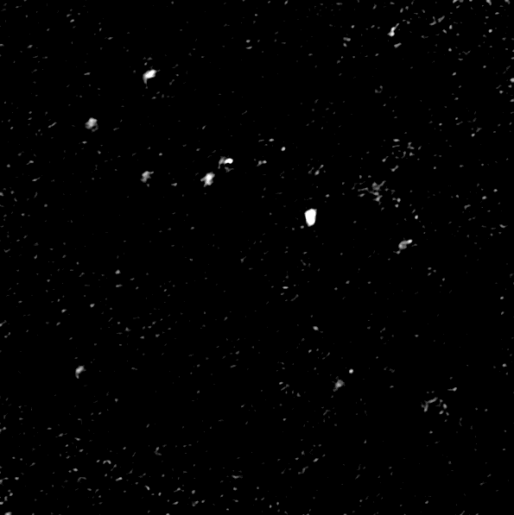

PANORAMA of mouse 43 (6-16-2022)
Time: 60 min
Count: 443 (Ex: 373; Large: 70)
Time: 60 min wash
Count: 148
Note: 37 % response to miRNA-21
0 % response to GFP
Scale bar: 10 µm

Slide 4
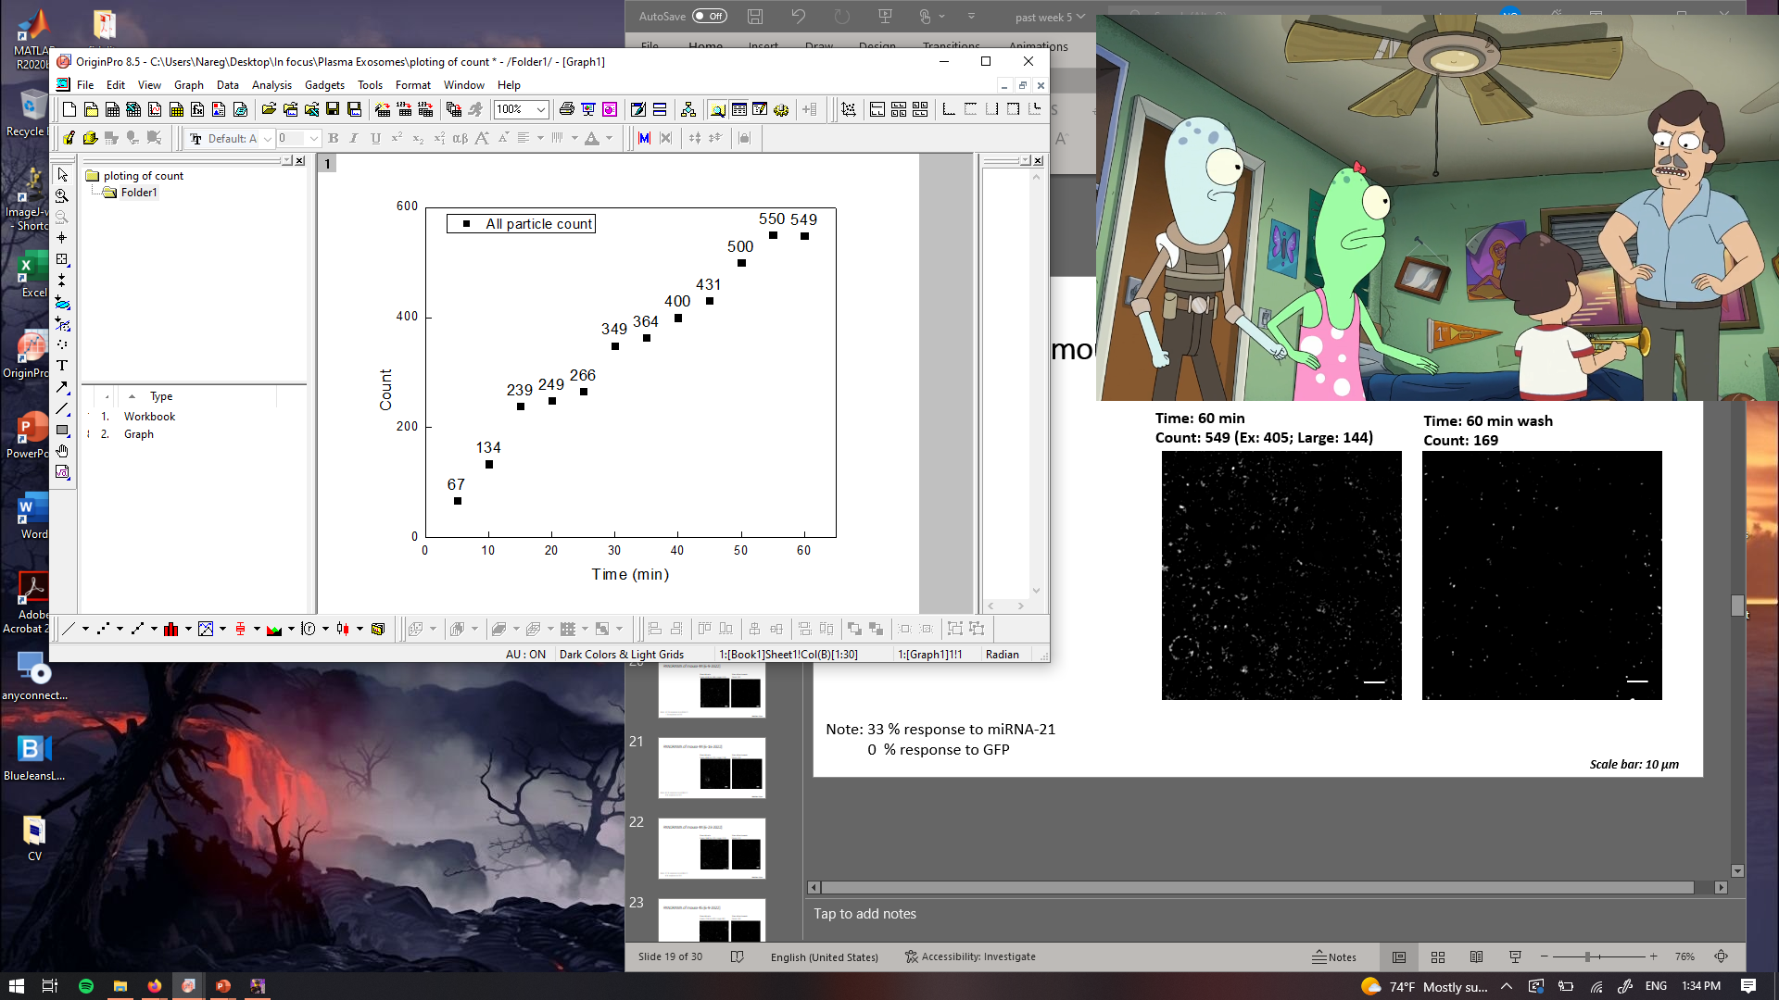
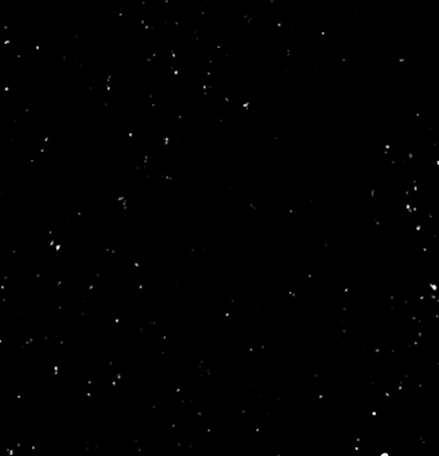
PANORAMA of mouse 43 (6-23-2022)
Time: 60 min
Count: 549 (Ex: 405; Large: 144)
Time: 60 min wash
Count: 169
Note: 33 % response to miRNA-21
0 % response to GFP
Scale bar: 10 µm

Slide 5
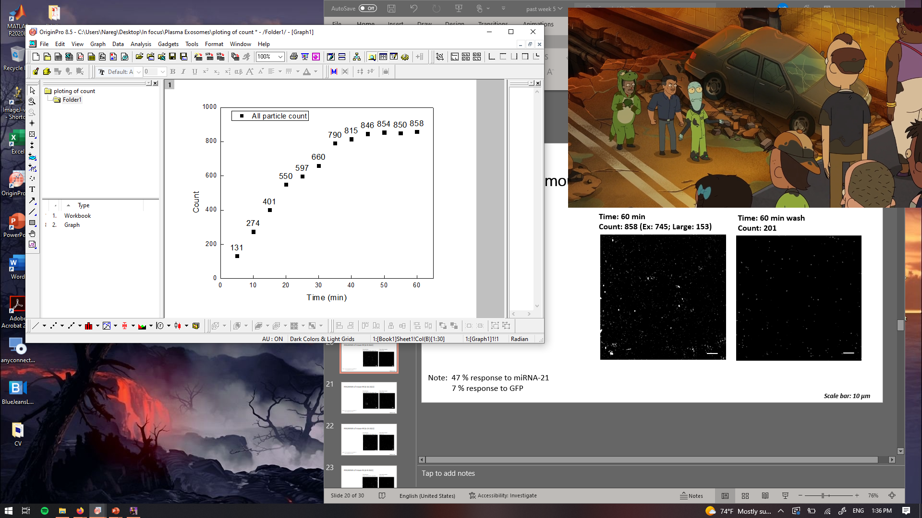

PANORAMA of mouse 44 (6-9-2022)
Time: 60 min
Count: 858 (Ex: 745; Large: 153)
Time: 60 min wash
Count: 201
Note: 47 % response to miRNA-21
7 % response to GFP
Scale bar: 10 µm

Slide 6
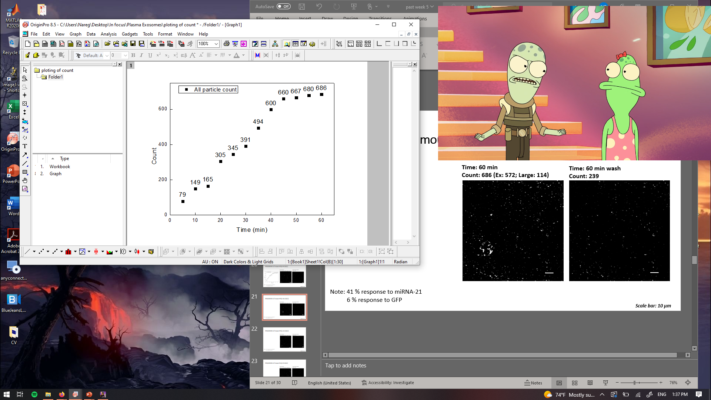
PANORAMA of mouse 44 (6-16-2022)
Time: 60 min
Count: 686 (Ex: 572; Large: 114)
Time: 60 min wash
Count: 239
Note: 41 % response to miRNA-21
6 % response to GFP
Scale bar: 10 µm

Slide 7
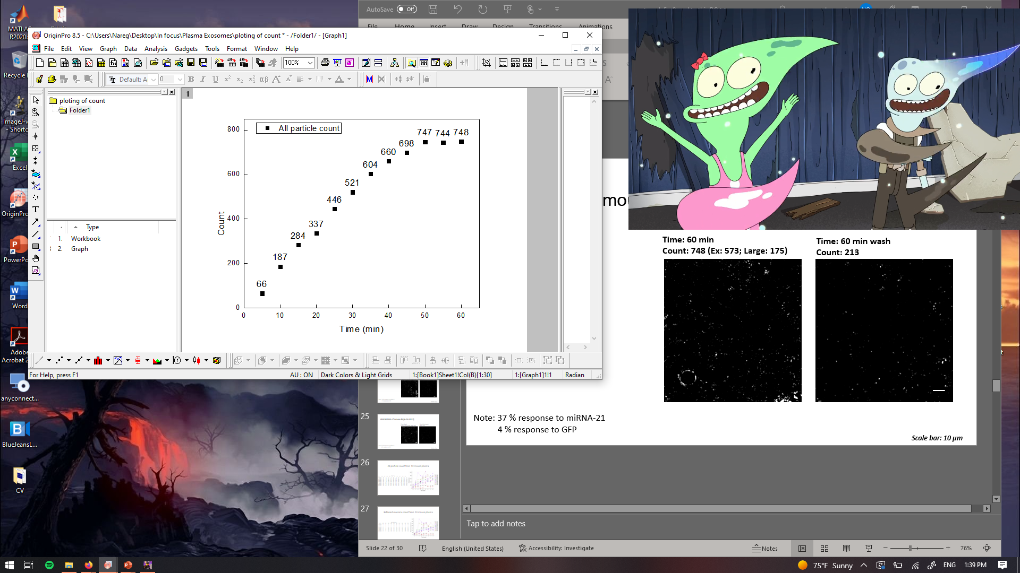
PANORAMA of mouse 44 (6-23-2022)
Time: 60 min
Count: 748 (Ex: 573; Large: 175)
Time: 60 min wash
Count: 213
Note: 37 % response to miRNA-21
4 % response to GFP
Scale bar: 10 µm

Slide 8
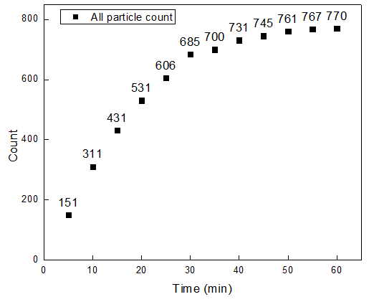
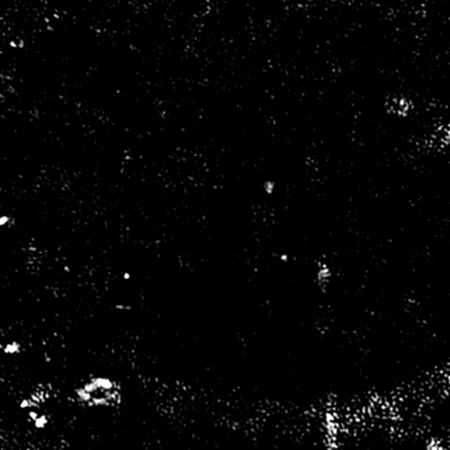

PANORAMA of mouse 45 (6-9-2022)
Time: 60 min
Count: 770 (Ex: 672; Large: 98)
Time: 60 min wash
Count: 183
Note: 44 % response to miRNA-21
6 % response to GFP
Scale bar: 10 µm

Slide 9
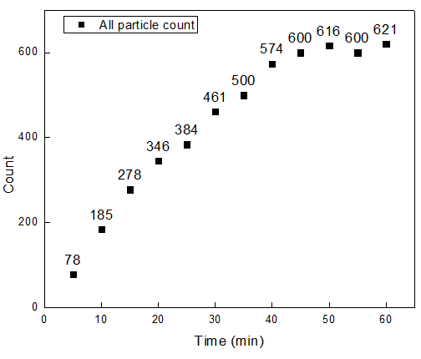
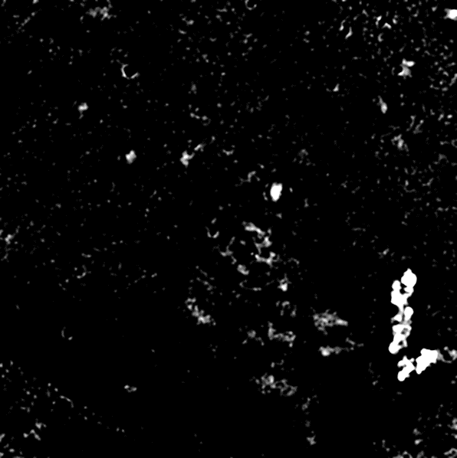

PANORAMA of mouse 45 (6-16-2022)
Time: 60 min
Count: 621 (Ex: 502; Large: 119)
Time: 60 min wash
Count: 187
Note: 29 % response to miRNA-21
7 % response to GFP
Scale bar: 10 µm

Slide 10
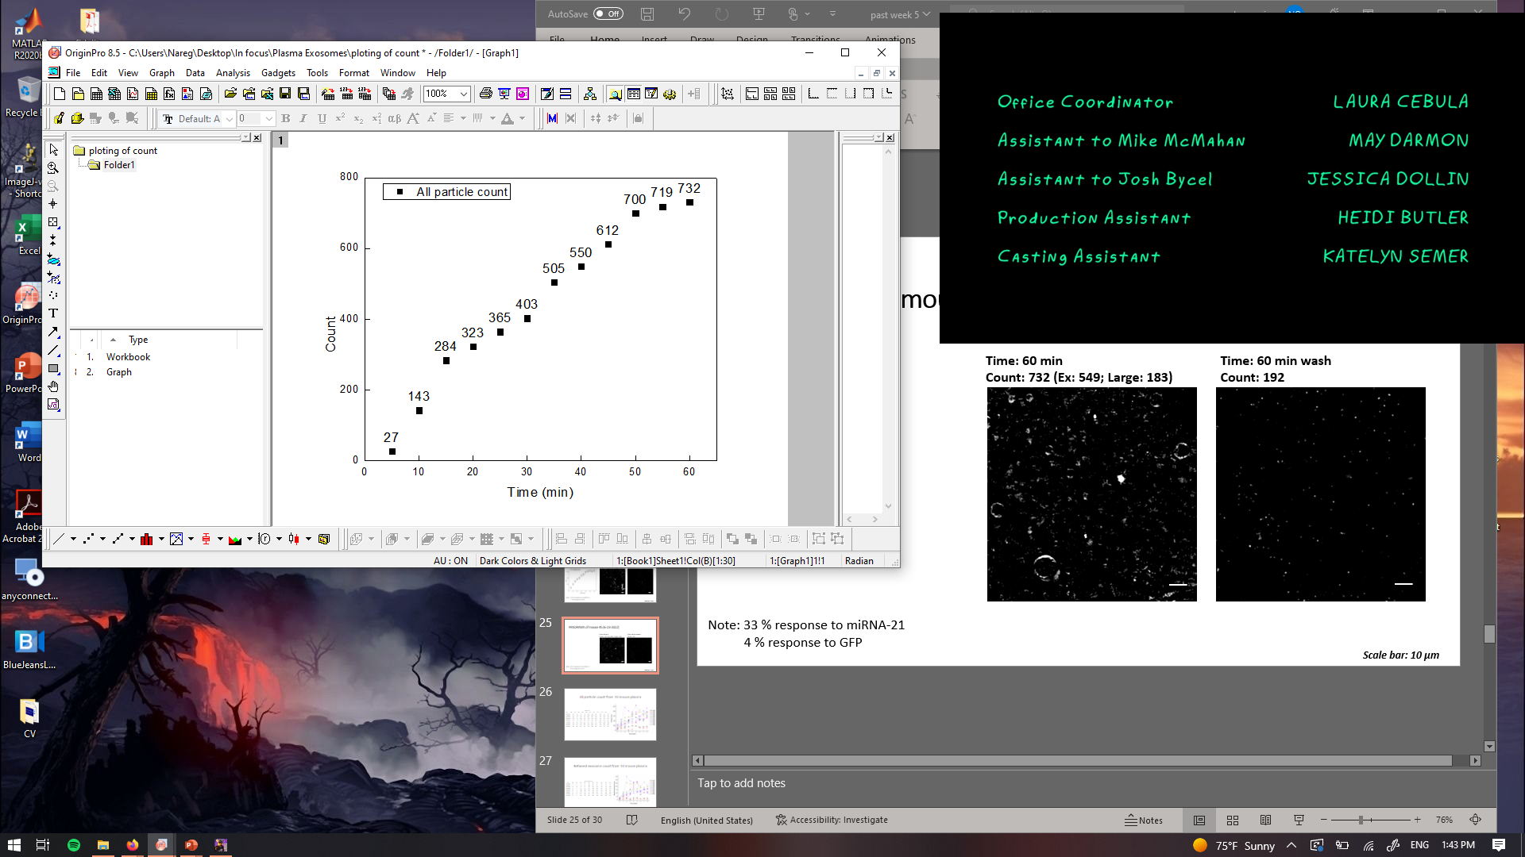
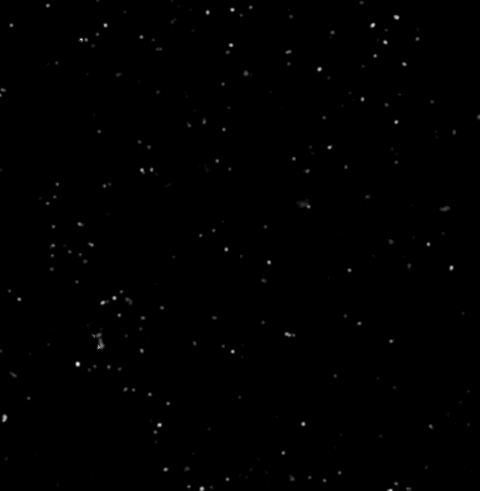
PANORAMA of mouse 45 (6-23-2022)
Time: 60 min
Count: 732 (Ex: 549; Large: 183)
Time: 60 min wash
Count: 192
Note: 33 % response to miRNA-21
4 % response to GFP
Scale bar: 10 µm

Slide 11
All particle count from 10 mouse plasma
All Particles
Time | #36 | #37 | #38 | #39 | #40 | #41 | #42 | #43 | #44 | #45
4/28/2022 | 248 | 27 | 67 | 48 | 193 | 86 | 194 | 248 | 134 | 111
5/5/2022 | 117 | 69 | 237 | 214 | 360 | 299 | 291 | 459 | 168 | 114
5/12/2022 | 138 | 97 | 287 | 271 | 404 | 191 | 969 | 277 | 288 | 539
5/19/2022 | 159 | 14 | 408 | 445 | 378 | 319 | 813 | 433 | 416 | 557
5/26/2022 | 192 | 40 | 470 | 289 | 587 | 375 | 695 | 766 | 632 | 673
6/2/2022 | 182 | 342 | 539 | 414 | 545 | 331 | 772 | 1052 | 669 | 698
6/9/2022 | 138 | 115 | 418 | 606 | 475 | 582 | 461 | 452 | 858 | 770
6/16/2022 | 149 | 91 | 813 | 485 | 402 | 688 | 481 | 443 | 686 | 621
6/23/2022 | 168 | 105 | 632 | 505 | 597 | 790 | 925 | 549 | 748 | 732

Slide 12
Retained exosome count from 10 mouse plasma
Retained Exosomes
Time | #36 | #37 | #38 | #39 | #40 | #41 | #42 | #43 | #44 | #45
4/28/2022 | 9 | 3 | 4 | 3 | 15 | 32 | 21 | 32 | 27 | 24
5/5/2022 | 7 | 8 | 52 | 53 | 109 | 65 | 85 | 84 | 45 | 27
5/12/2022 | 18 | 26 | 75 | 24 | 116 | 93 | 353 | 63 | 29 | 260
5/19/2022 | 13 | 1 | 92 | 84 | 147 | 105 | 285 | 161 | 73 | 237
5/26/2022 | 28 | 7 | 100 | 188 | 161 | 133 | 263 | 254 | 206 | 231
6/2/2022 | 31 | 16 | 109 | 123 | 167 | 130 | 276 | 268 | 254 | 255
6/9/2022 | 12 | 11 | 123 | 113 | 76 | 137 | 134 | 77 | 201 | 183
6/16/2022 | 20 | 14 | 164 | 109 | 103 | 158 | 159 | 148 | 269 | 187
6/23/2022 | 24 | 5 | 100 | 107 | 122 | 160 | 120 | 169 | 213 | 192

Slide 13
MIR-21 occurrence among retained exosomes
MIR-21 Occurrence
Time | #36 | #37 | #38 | #39 | #40 | #41 | #42 | #43 | #44 | #45
4/28/2022 | 0 | 0 | 0 | 0 | 0 | 0 | 0 | 0 | 0 | 0
5/5/2022 | 0 | 0 | 27.5 | 0 | 35 | 0 | 0 | 5 | 0 | 0
5/12/2022 | 0 | 0 | 46 | 23 | 40 | 29 | 56 | 31 | 0 | 17
5/19/2022 | 0 | 0 | 33.7 | 41 | 39 | 45 | 38.5 | 35 | 15 | 63
5/26/2022 | 0 | 0 | 59.5 | 39 | 43 | 41.3 | 41 | 41 | 58 | 51
6/2/2022 | 0 | 0 | 48 | 54 | 45 | 39 | 46 | 45 | 37 | 37
6/9/2022 | 0 | 0 | 25 | 31 | 22.6 | 35 | 40 | 31 | 47 | 44
6/16/2022 | 0 | 0 | 42 | 29 | 29 | 36 | 22 | 37 | 41 | 29
6/23/2022 | 0 | 0 | 39 | 33 | 13 | 31 | 17.5 | 33 | 37 | 33

Slide 14
Time vs Retained Exosomes

Slide 15
Tumor Size vs Retained Exosomes

